Slide 1
HORSE BOOTS
FRONT BOOTS
Basically there is no restriction on front boots BUT where there are leather straps and buckles which can be tightened against the horses skin at front of front leg. This will cause rubbing and pain and is NOT allowed.
Velcro attachments have to be as the design intended and NO ROUGH VELCRO AGAINST HORSES LEG.

Slide 2
HORSES GENERAL COMPETITIONS
HIND BOOTS
Types of boots now allowed.
Boots with the spec for Young Horse competitions which is covered later.
Art. 257.2.4.
Boots that have a protective element on inside only.
Boots that have a protective element on inside and outside, that is double shell boots that wrap round back of fetlock.
The boots mentioned above MUST conform to the following:
Maximum length at longest point must be 20cms---this does not include extra length of a protective part.
They must be fitted correctly with protective part/s where they should be around fetlock.
Sheepskin linings are allowed.

Slide 3
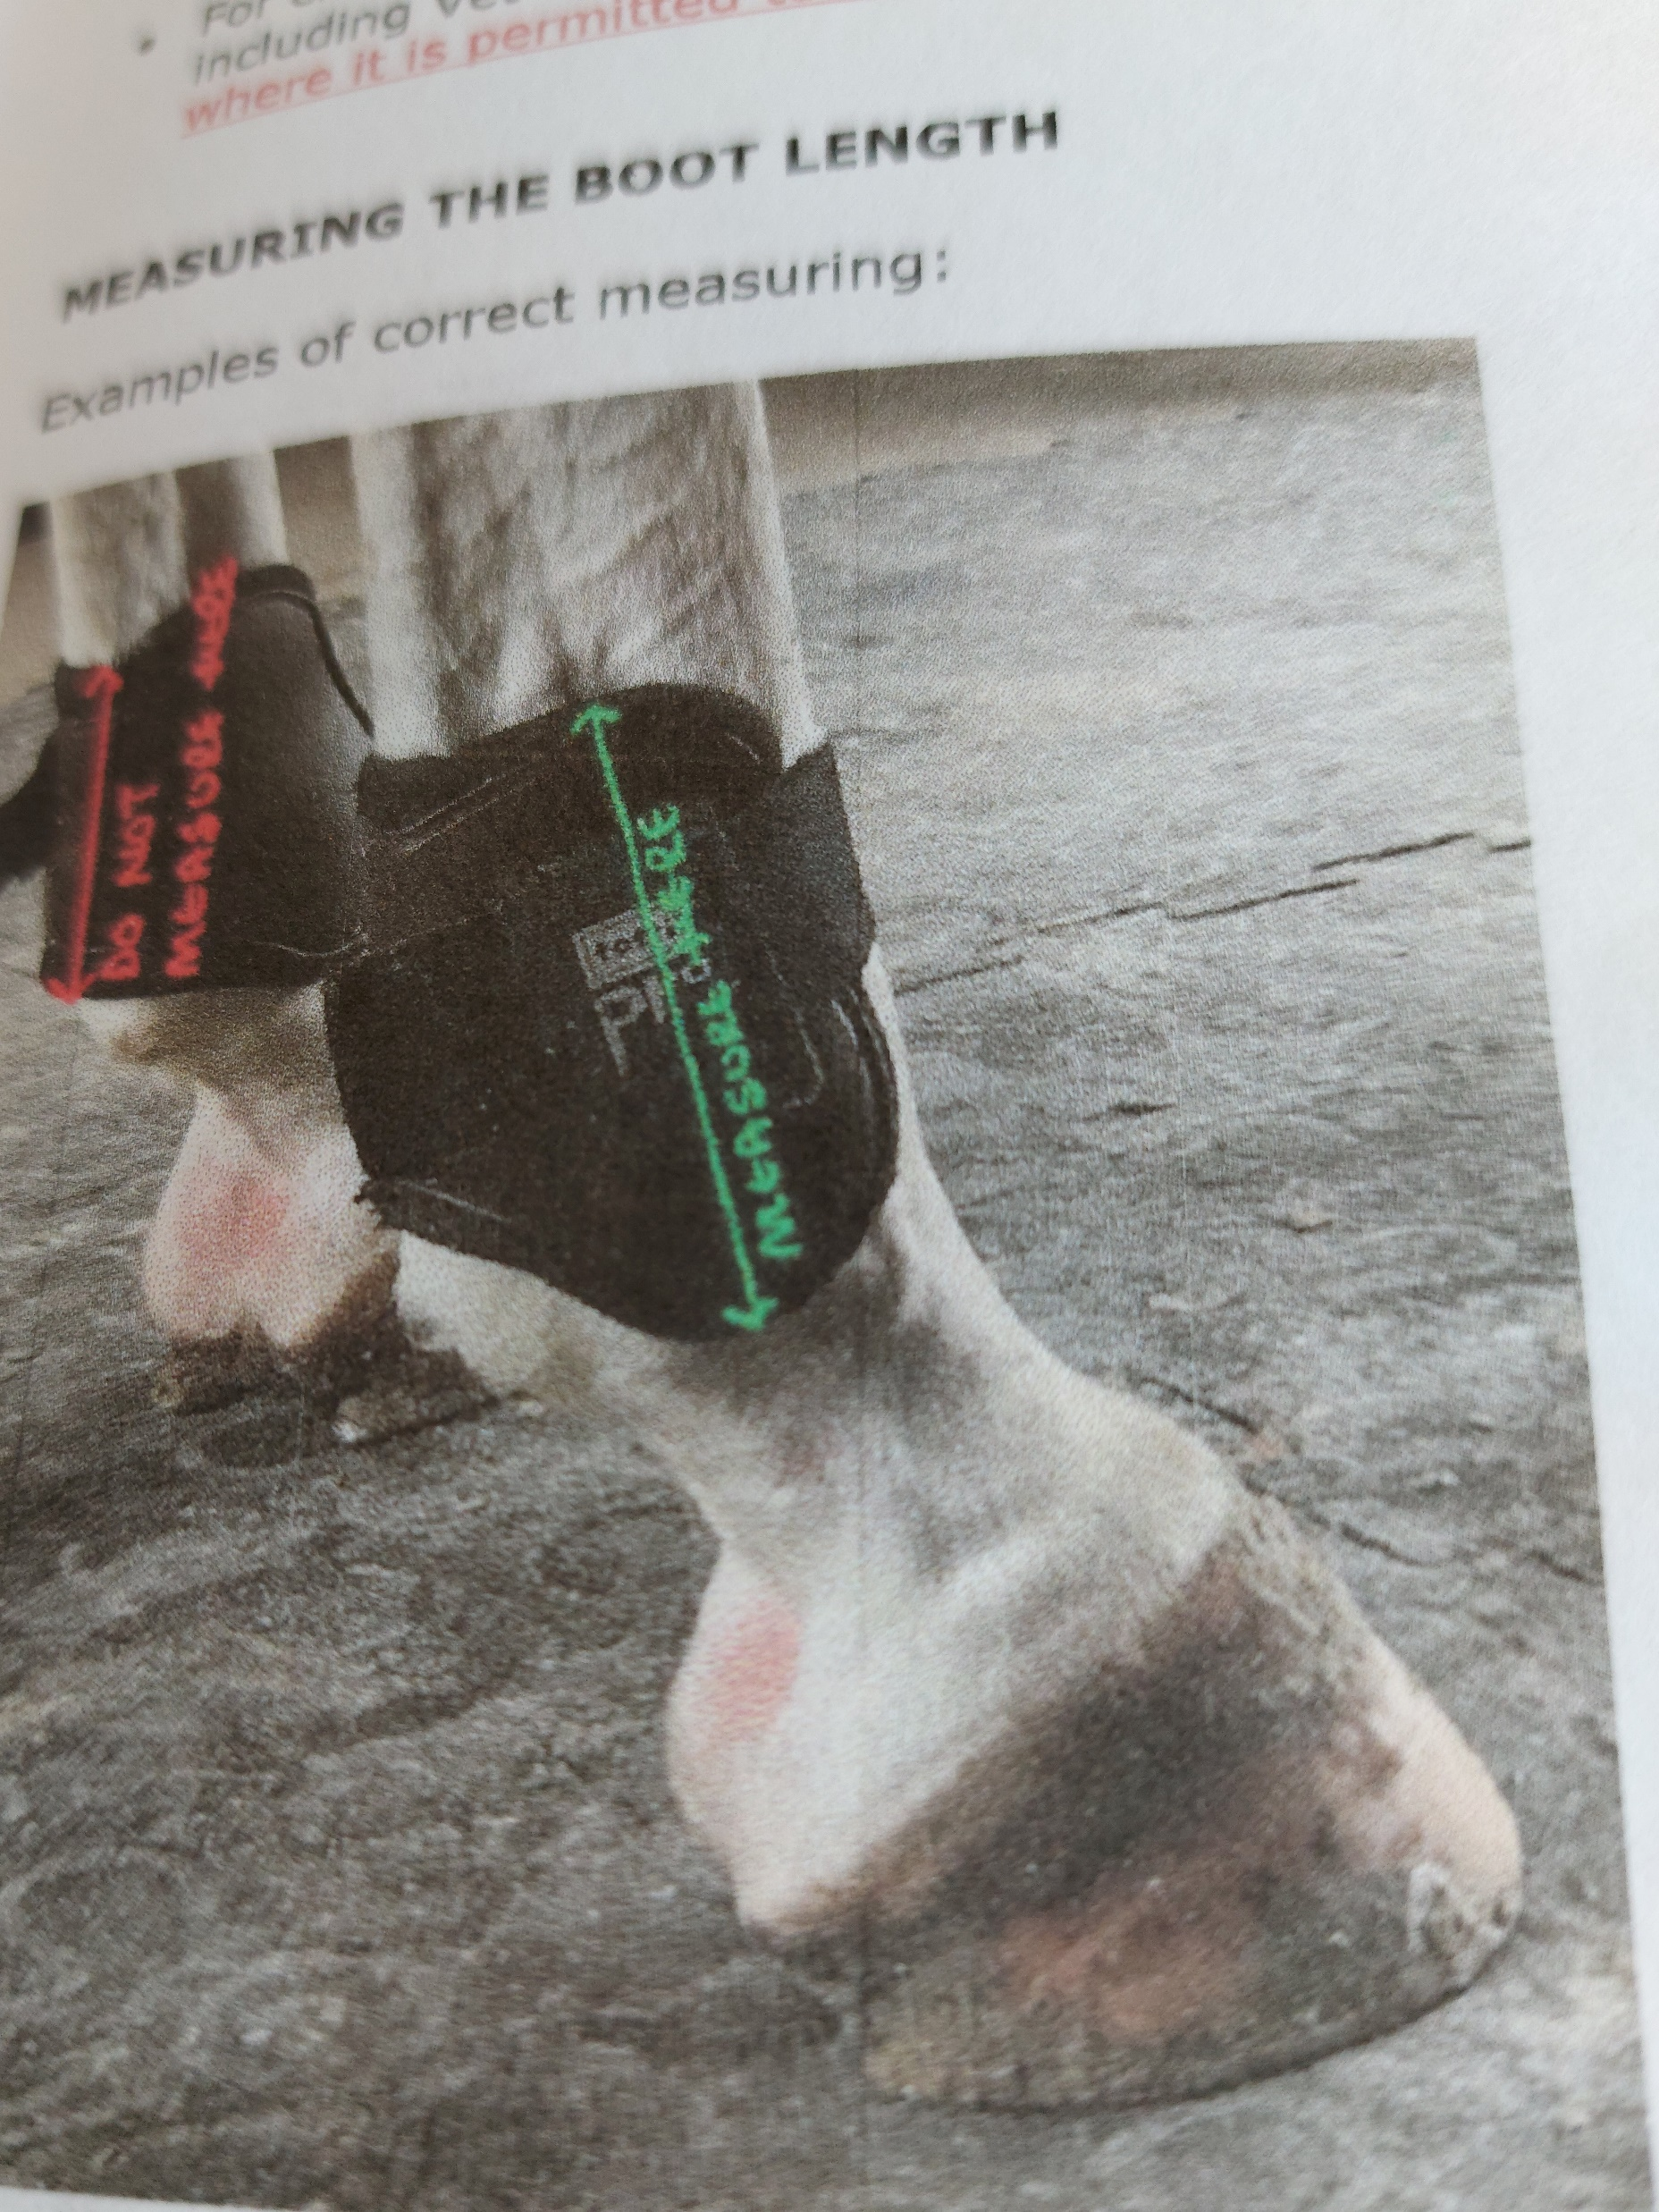
Measurement of boots.
For boots other than young horse boots length measured as shown must be not longer than 20cms

Slide 4
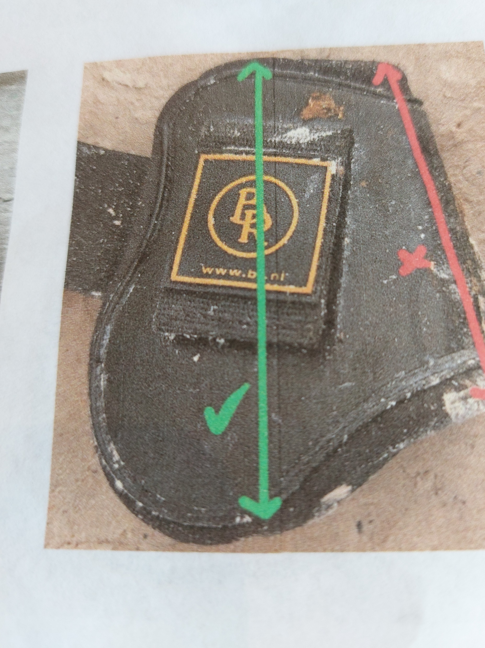
20cms max. measured as shown.

Slide 5
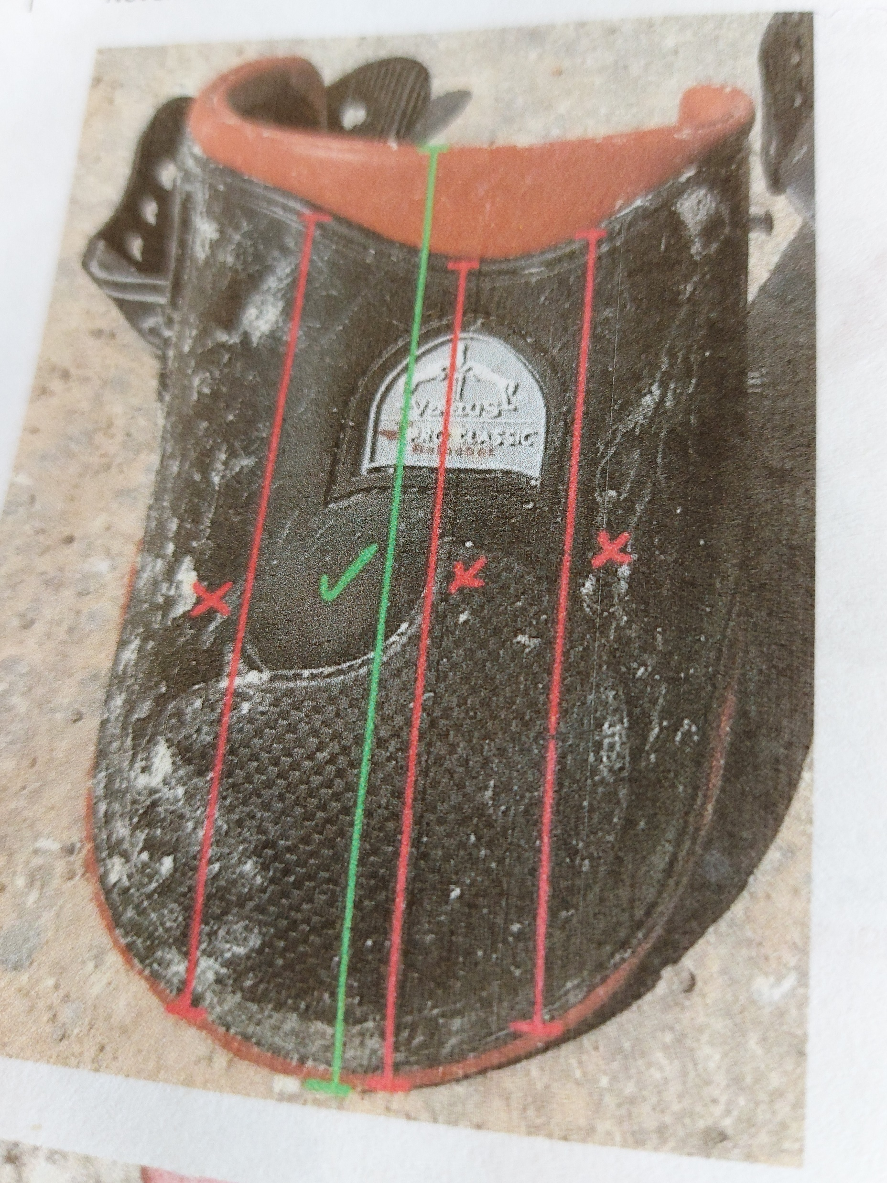
With protection on inside only measurement shown must be 20cms or less.

Slide 6
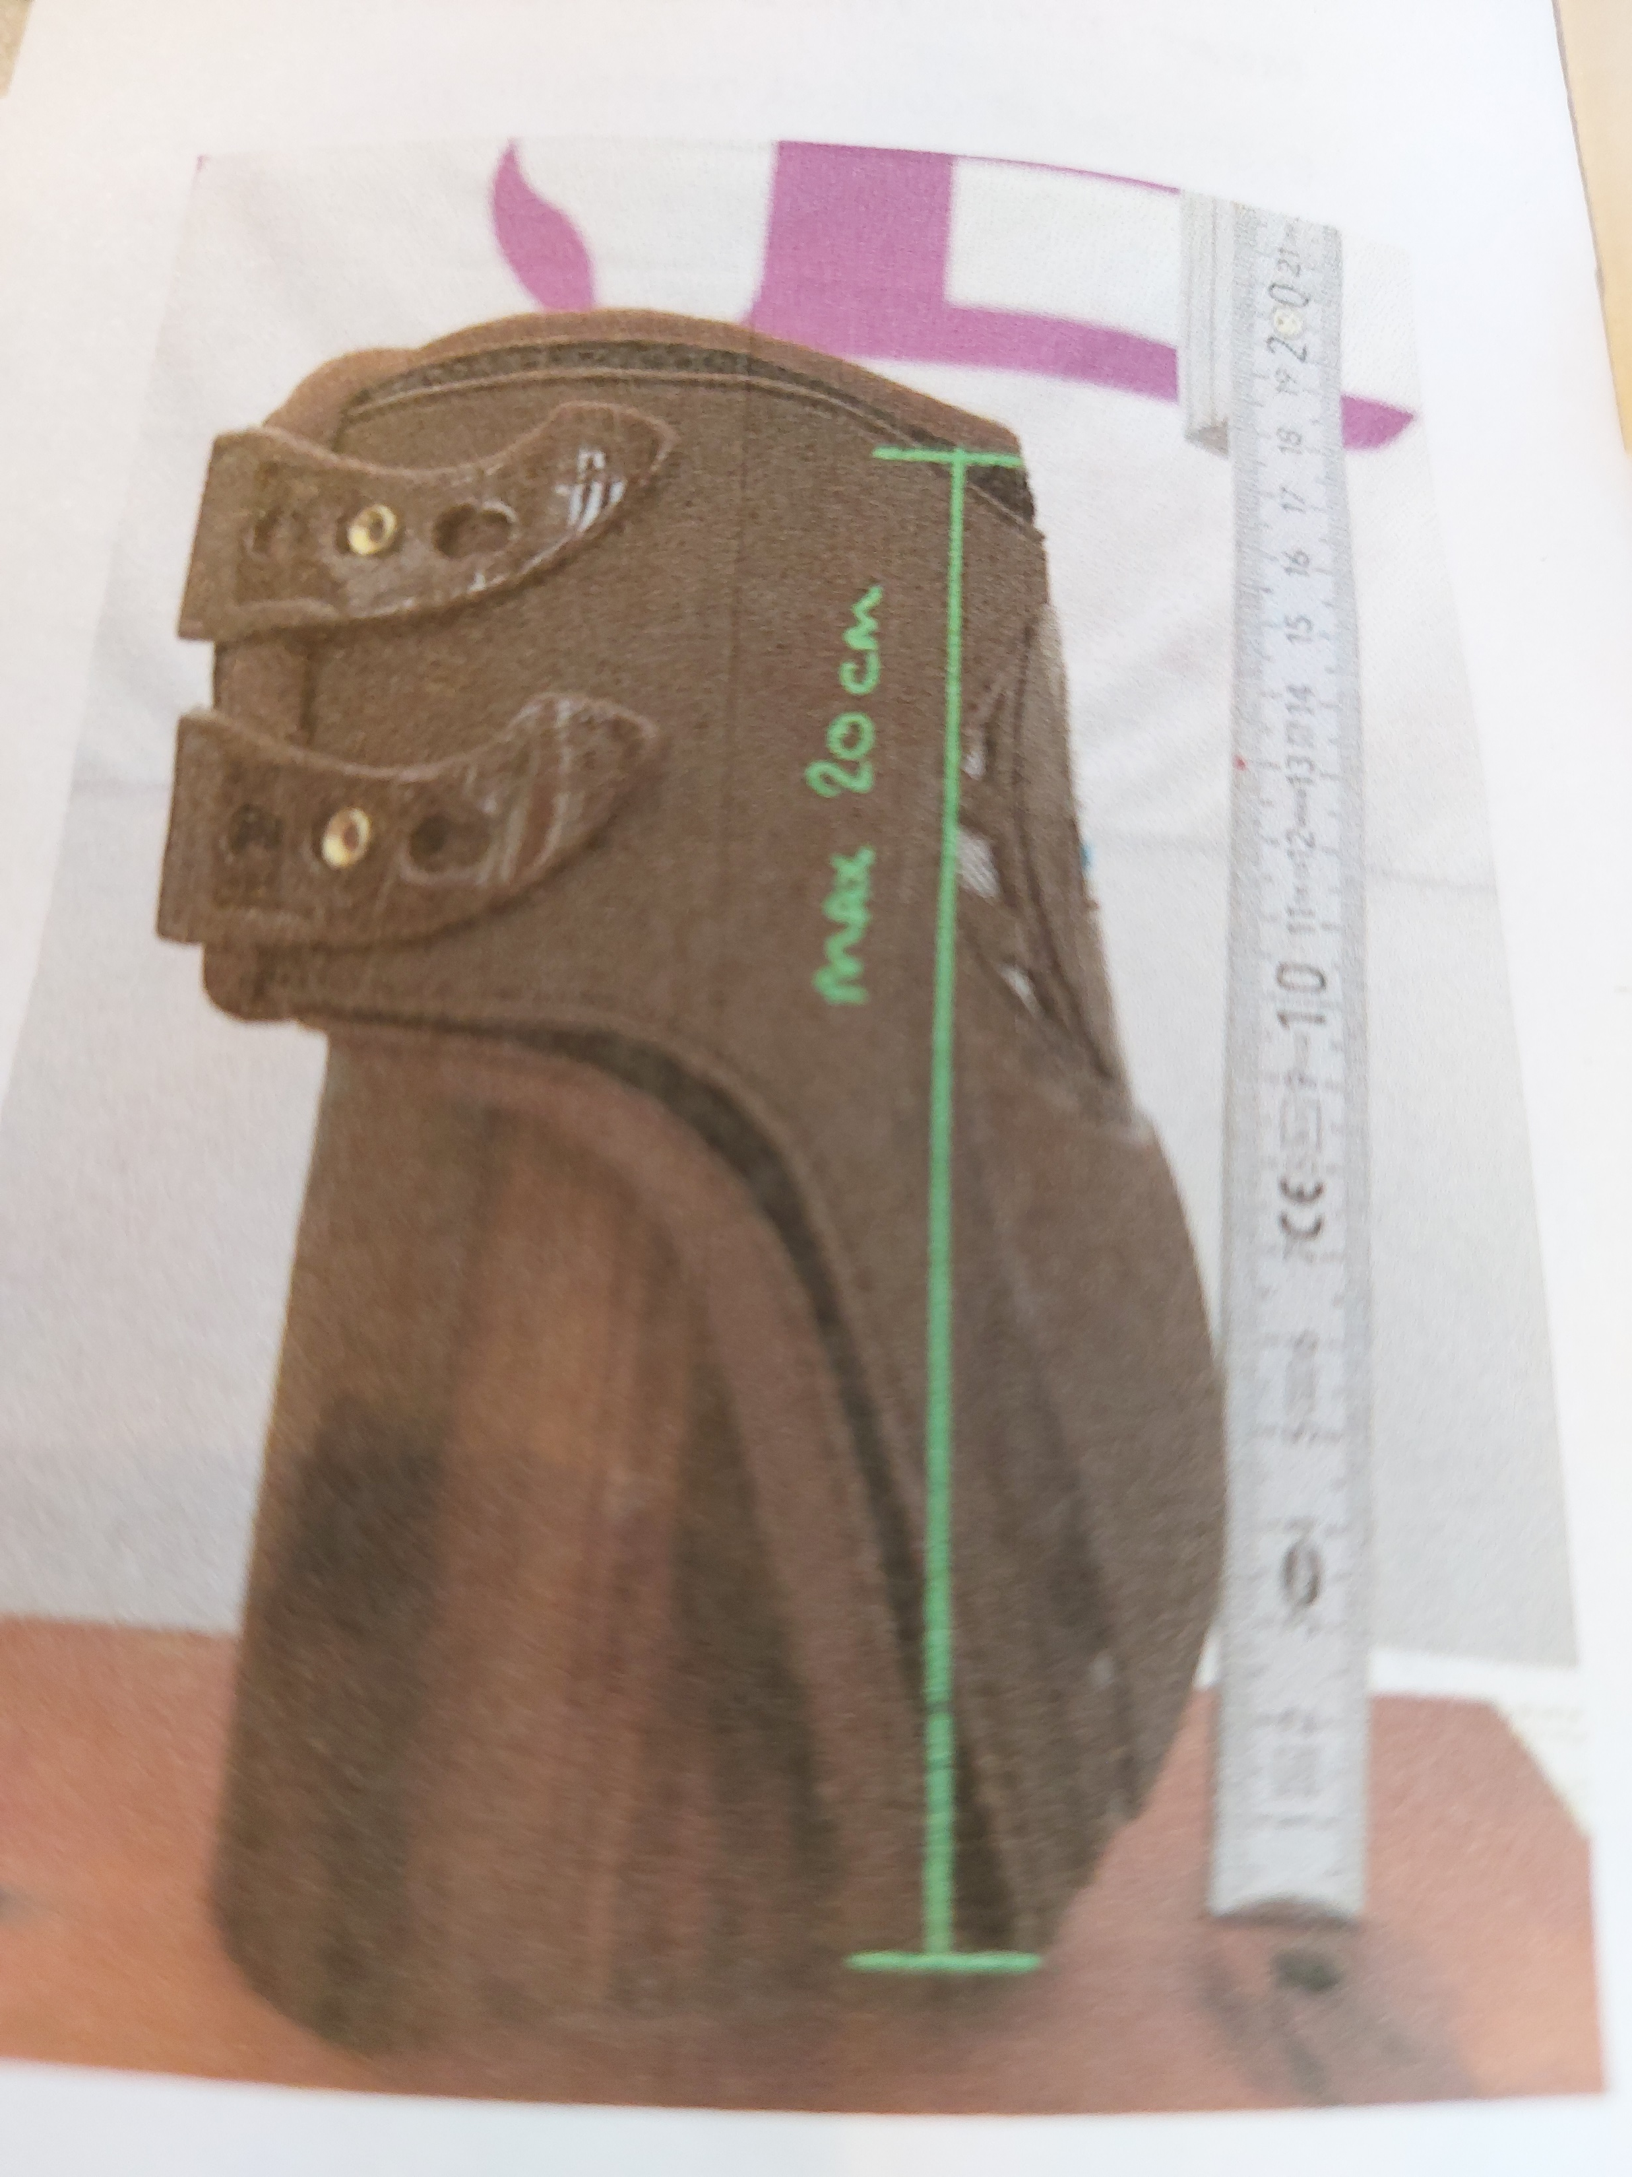
Again showing measurement with protection to inside.

Slide 7
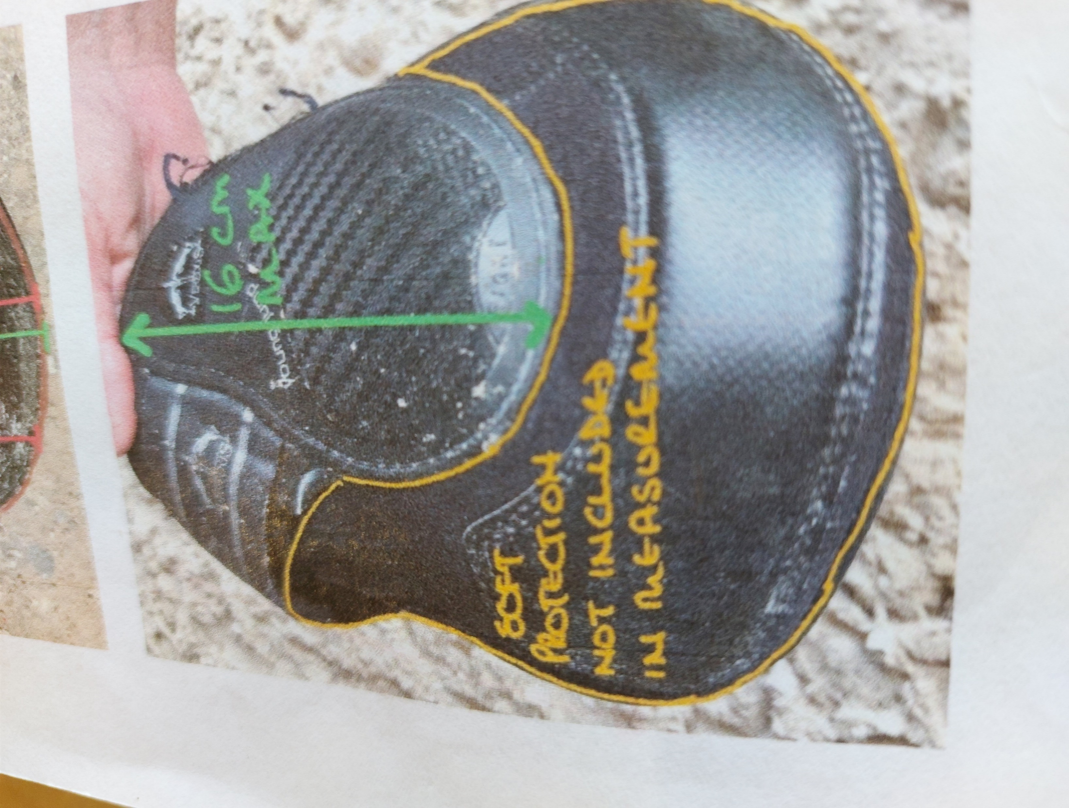
Boots with soft protection below, measurement not to include this. This slide actually shows measurement for a Young Horse boot max. 16cms.

Slide 8
Boots with inside protection only .
Maximum length measured as shown is 20cms.
Boots with Velcro fastenings single strap must be minimum of 5cms.
                Two straps, each must be minimum of 2.5cms
                The above boot straps may be elastic or non- elastic
            Stud Fastenings 1 or 2 ELASTIC straps minimum width 2.5cms
            Hook Fastenings 1 or 2 ELASTIC straps minimum width 2.5cms

Slide 9
DOUBLE SHELL / WRAP AROUND
Maximum length is 20cms measured as shown previously
Velcro fastenings 1 strap minimum width 5cms
Two straps minimum width is 2.5cms each strap
Stud fastenings 1 or 2 straps minimum width is 2.5cms each strap
Hook fastenings 1 or 2 straps minimum width 2.5cms
ALL STRAPS MUST BE ELASTIC

Slide 10
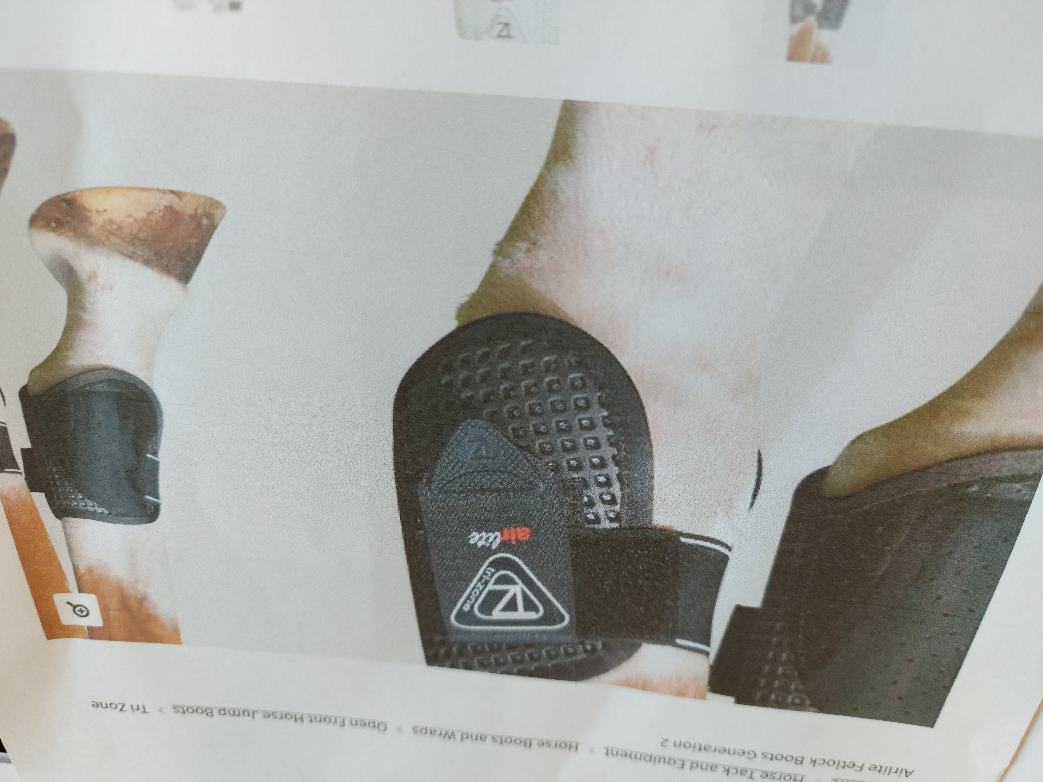
Example of double shell boot with one Velcro strap which MUST be elastic with minimum width 5cms

Slide 11
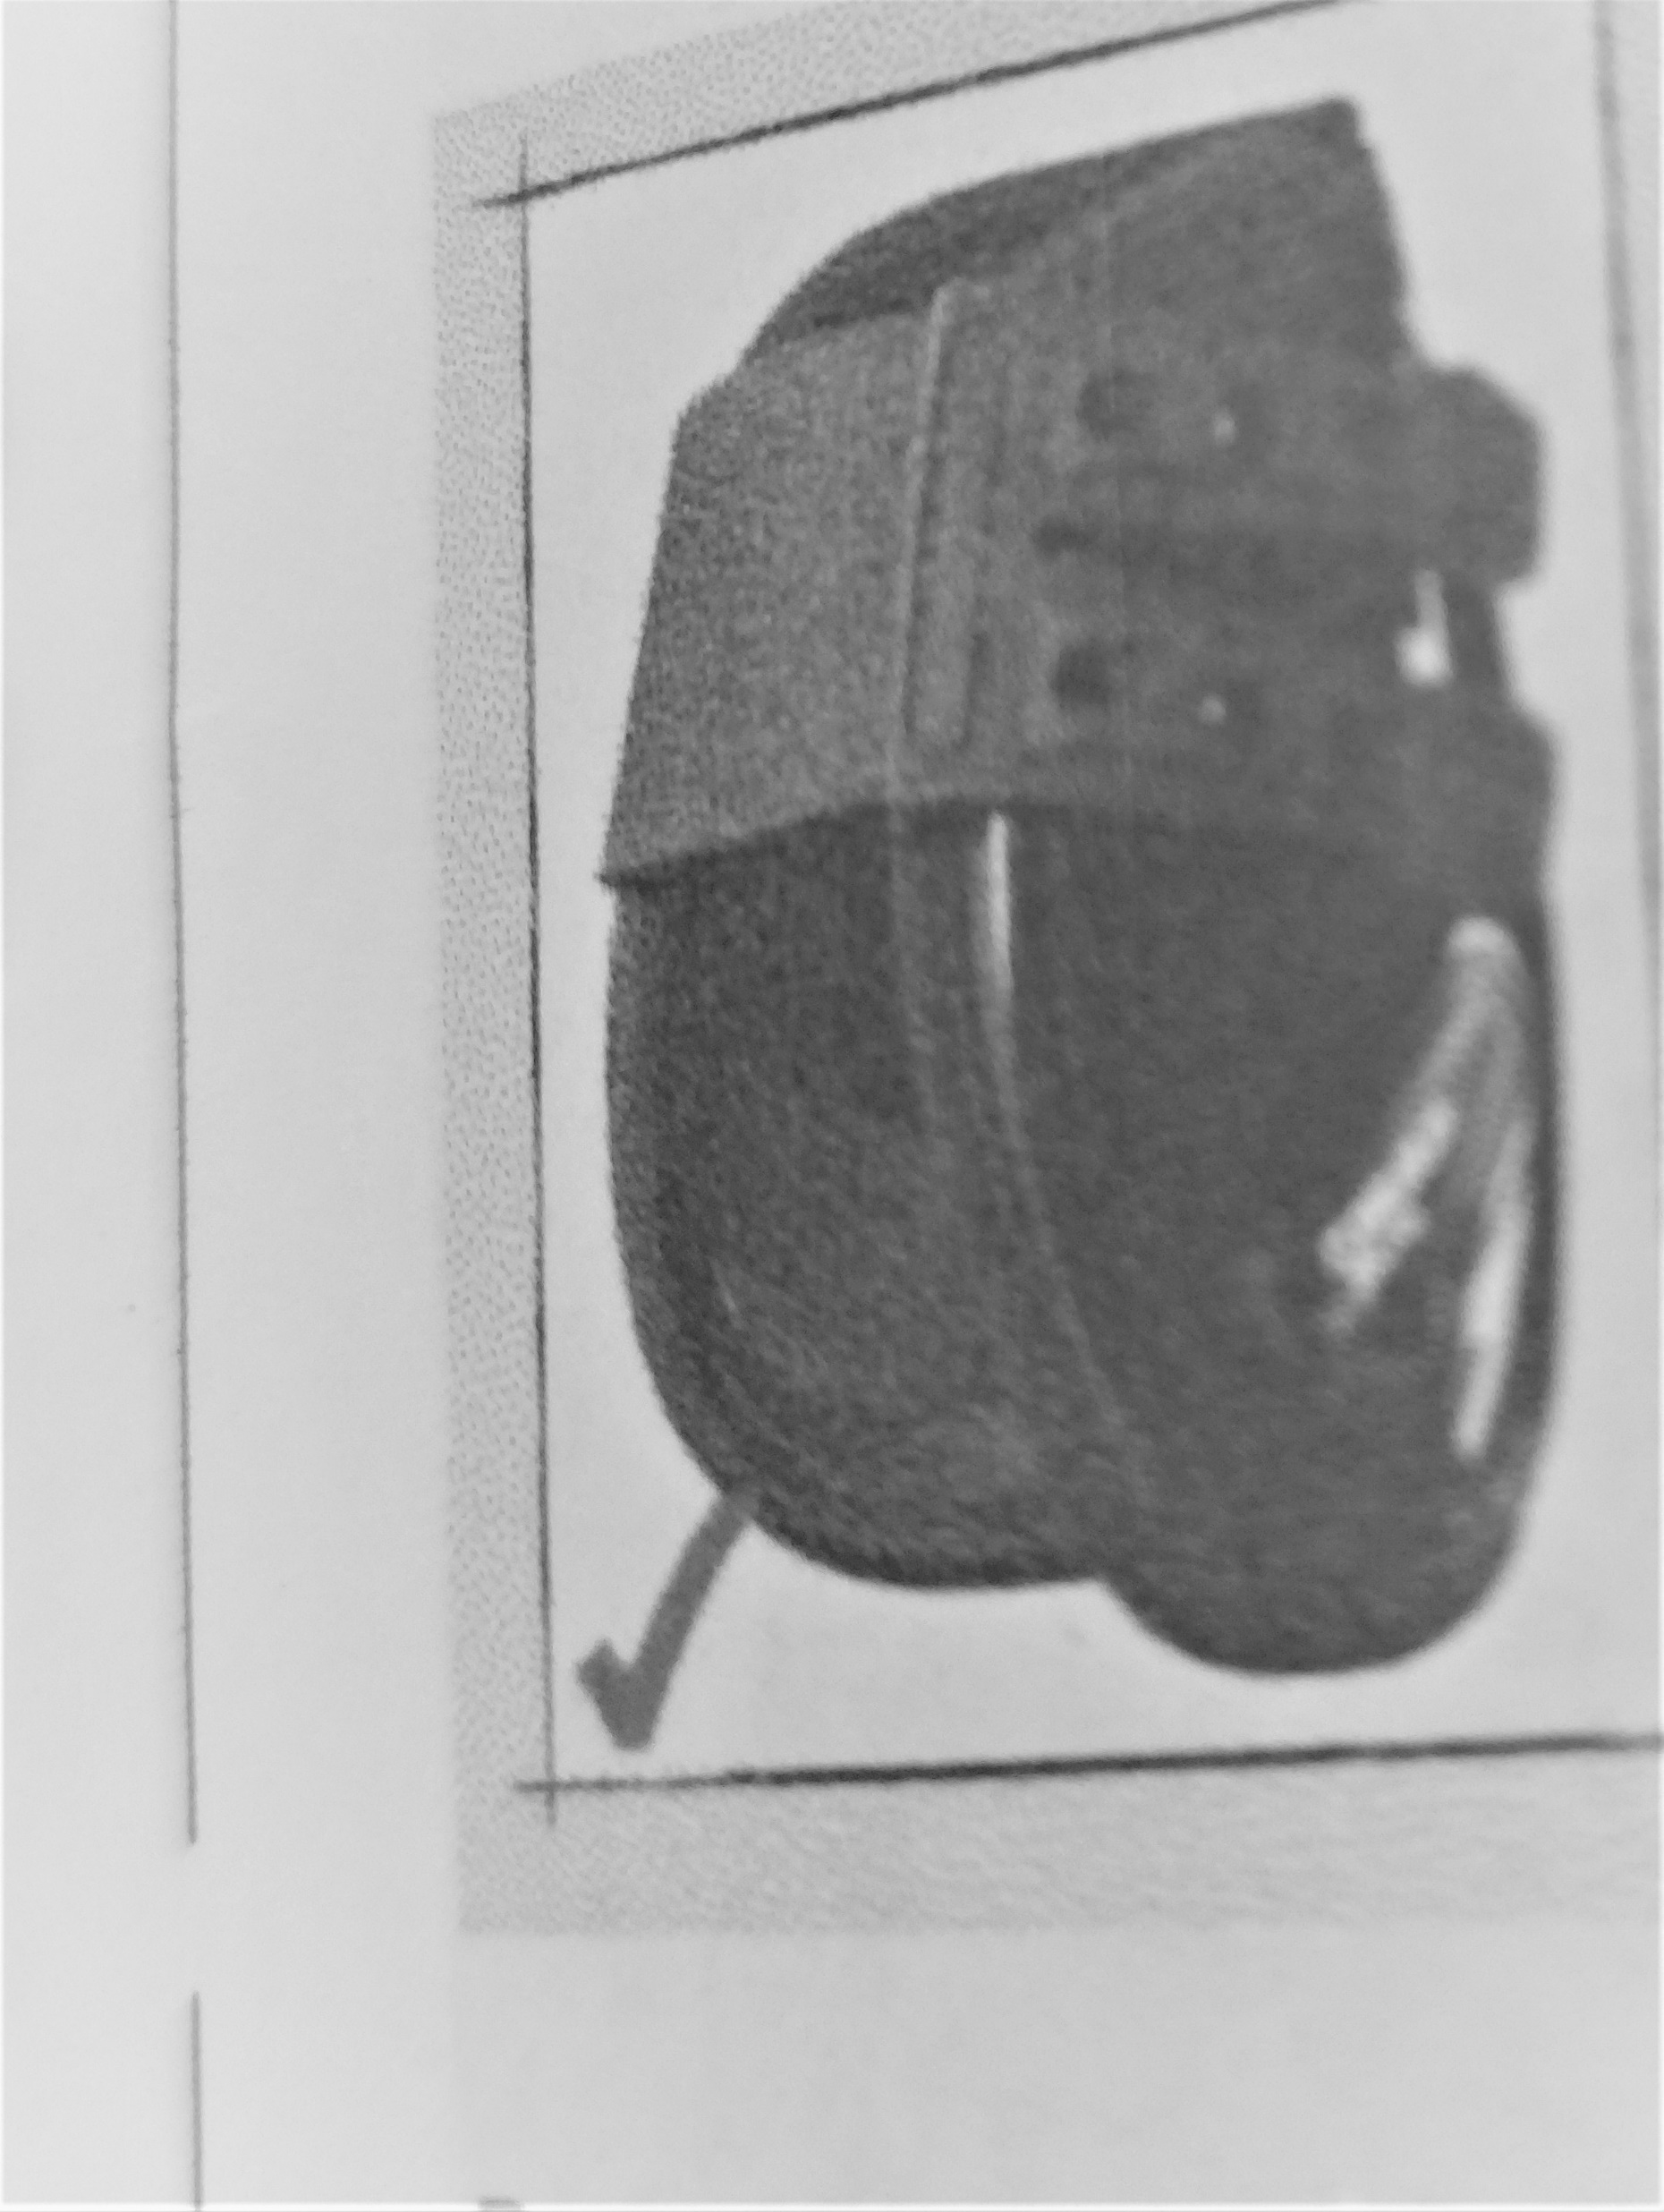
Boots with a single strap which splits into two to fasten are allowed.(Provided strap is elastic and minimum width in this case 5cm splits into two of at least 2.5cm)

Slide 12
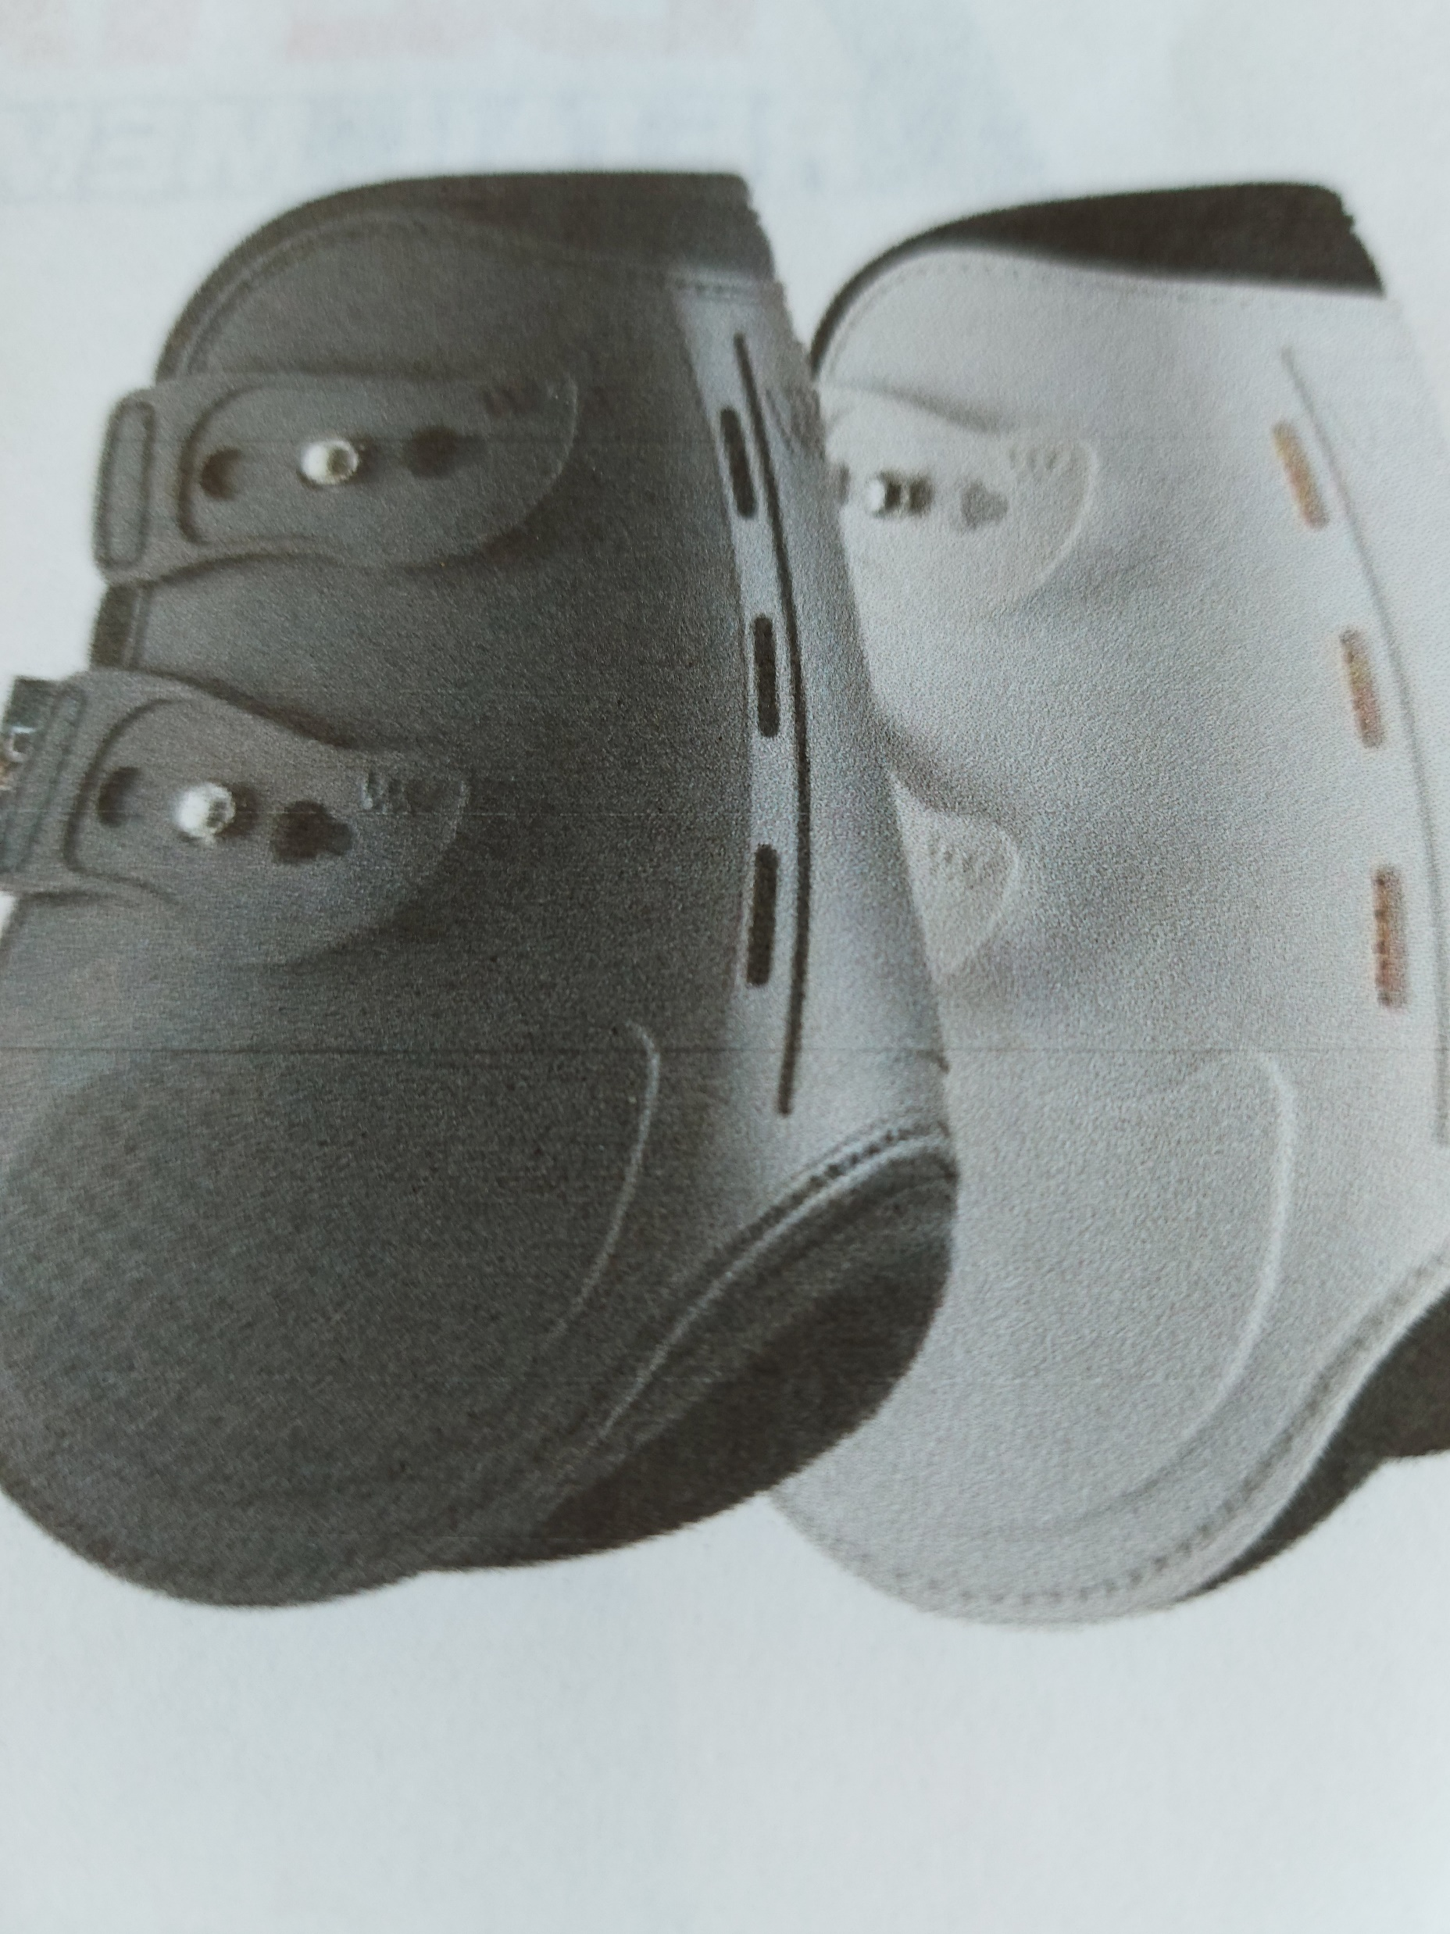
Double Shell boots with stud type fasteners, with two straps, must be elastic,

Slide 13
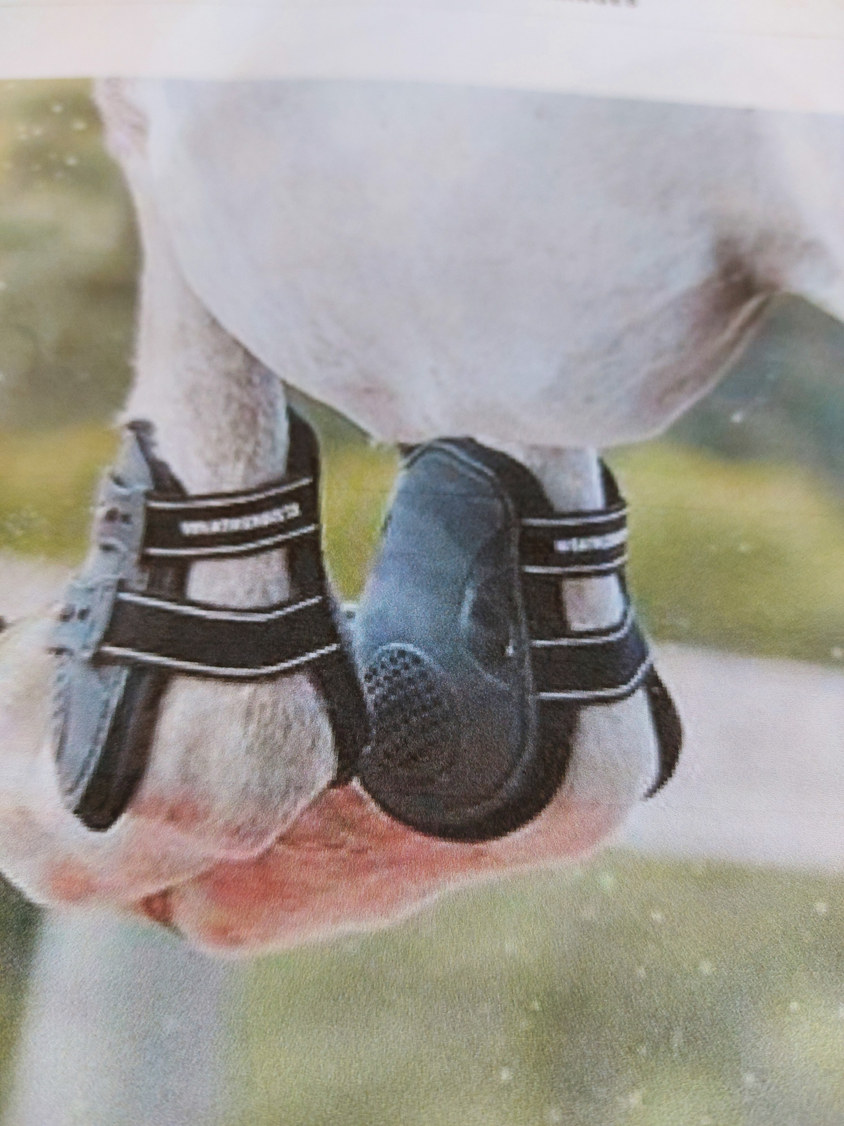
Front view of double shell boots two straps and stud fastenings. Elastic straps.

Slide 14
HOOK TYPE FASTENERS
Each strap must be elastic
Have a minimum width of 2.5cms
Have a hook at the end that fits into an eyelet.

Slide 15
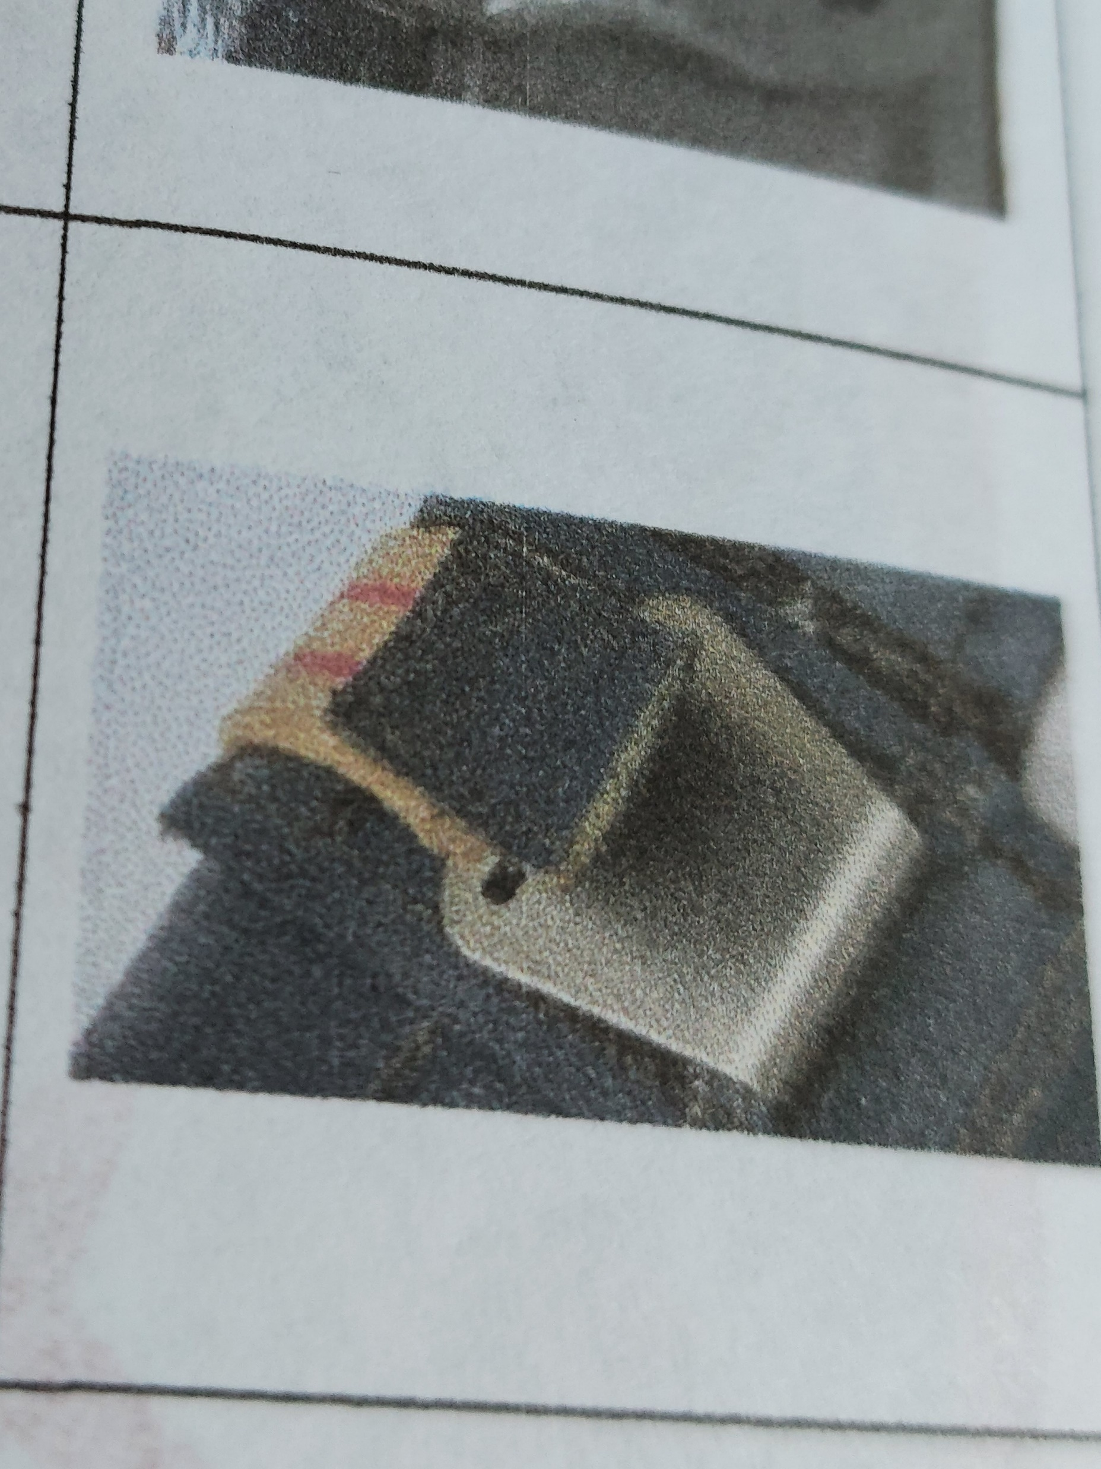
Hook Type Fasteners One or two straps. Must be elastic.

Slide 16
FASTNERS CONT.
All Fasteners must be one-directional , THAT IS, THE FASTENER MUST BE attached directly from one side of the boot to the other side but must not wrap around the entire boot.
NO DOUBLE CLICK MECHANISM ALLOWED.
NO ADDITIONAL ELEMENTS ADDED TO OR INSERTED INTO BOOT ITSELF. VET WRAP OR SIMILAR BANDAGING MATERIAL NOT ALLOWED UNDER HIND BOOT.
FETLOCK RINGS ARE ALLOWED BUT NOT PASTERN STRAPS.
Inside of boot must be smooth NO PRESSURE POINTS.(however there may be small areas where stitching is which are not smooth but are allowed as they are not hard pressure points.

Slide 17
Pull Up Socks
Pull Up socks may be used under hind boots
BUT NOT PRESSURE SOCKS

Slide 18
NOT ALLOWED
Any boot with a fastener system which has a mechanism that can cause extra leverage to be Applied is NOT ALLOWED.

Slide 19
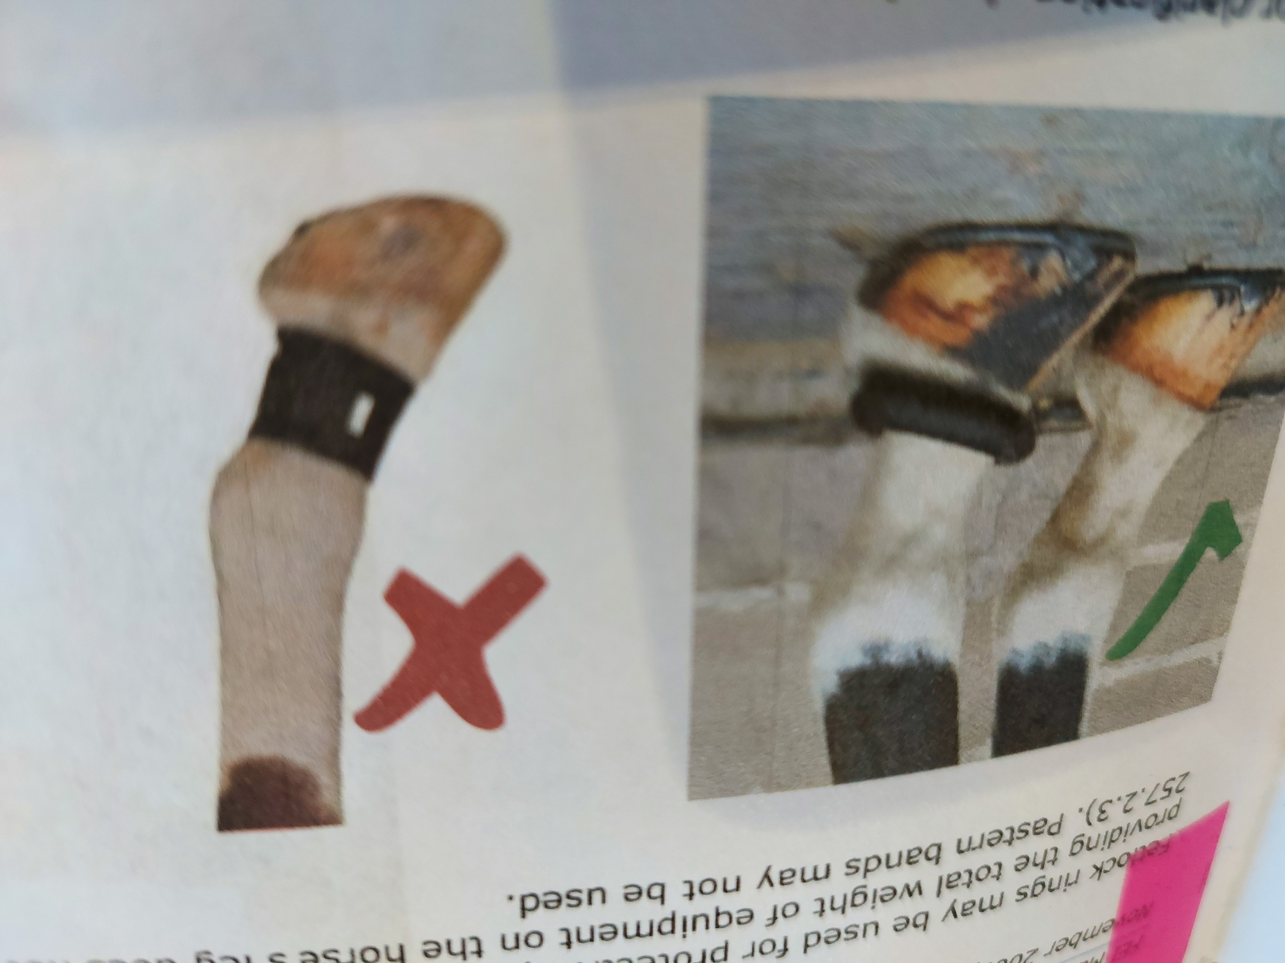
Clarification
Fetlock Rings are allowed
Pastern straps not allowed.

Slide 20
Young Horse Competitions
4/5/6/7&8 year olds
HIND BOOTS
Fetlock Boots must have NO elastic and smooth on the inside.
Art. 257.2.4N
The spec of the boots to be as follows:
For all Young Horse Competitions(four, five,six,seven and eight year old horses)

Slide 21
Spec. for Young Horse Boots
Only Velcro single strap, non elastic and max length 16cms. Measured as in previous slides.
For all Young Horse competitions ( five, six, seven and eight year old horses): All hind leg protections must have a maximum interior length of 16 cm; the width of the fastener must be at least 5cm.
The inside of the protection must be smooth, that is, the surface must be even and there may not be any
pressure points on the inside of the boot; sheepskin linings are allowed.

Slide 22
Cont.
Only non-elastic Velcro-type fasteners are permitted; no hooks, buckles, clips or other methods of attaching the fasteners may be used;
• The rounded rigid part of the protection must be placed around the inside of the fetlock;

Slide 23
CONT.
• No additional elements may be added to or inserted in the boot itself, other than a protective flap, providing it is soft and clearly intended for protection only.
Fetlock rings may be used for protective purposes providing they are properly adjusted and providing the total weight of equipment on the horse’s leg does not exceed 500 grams

Slide 24
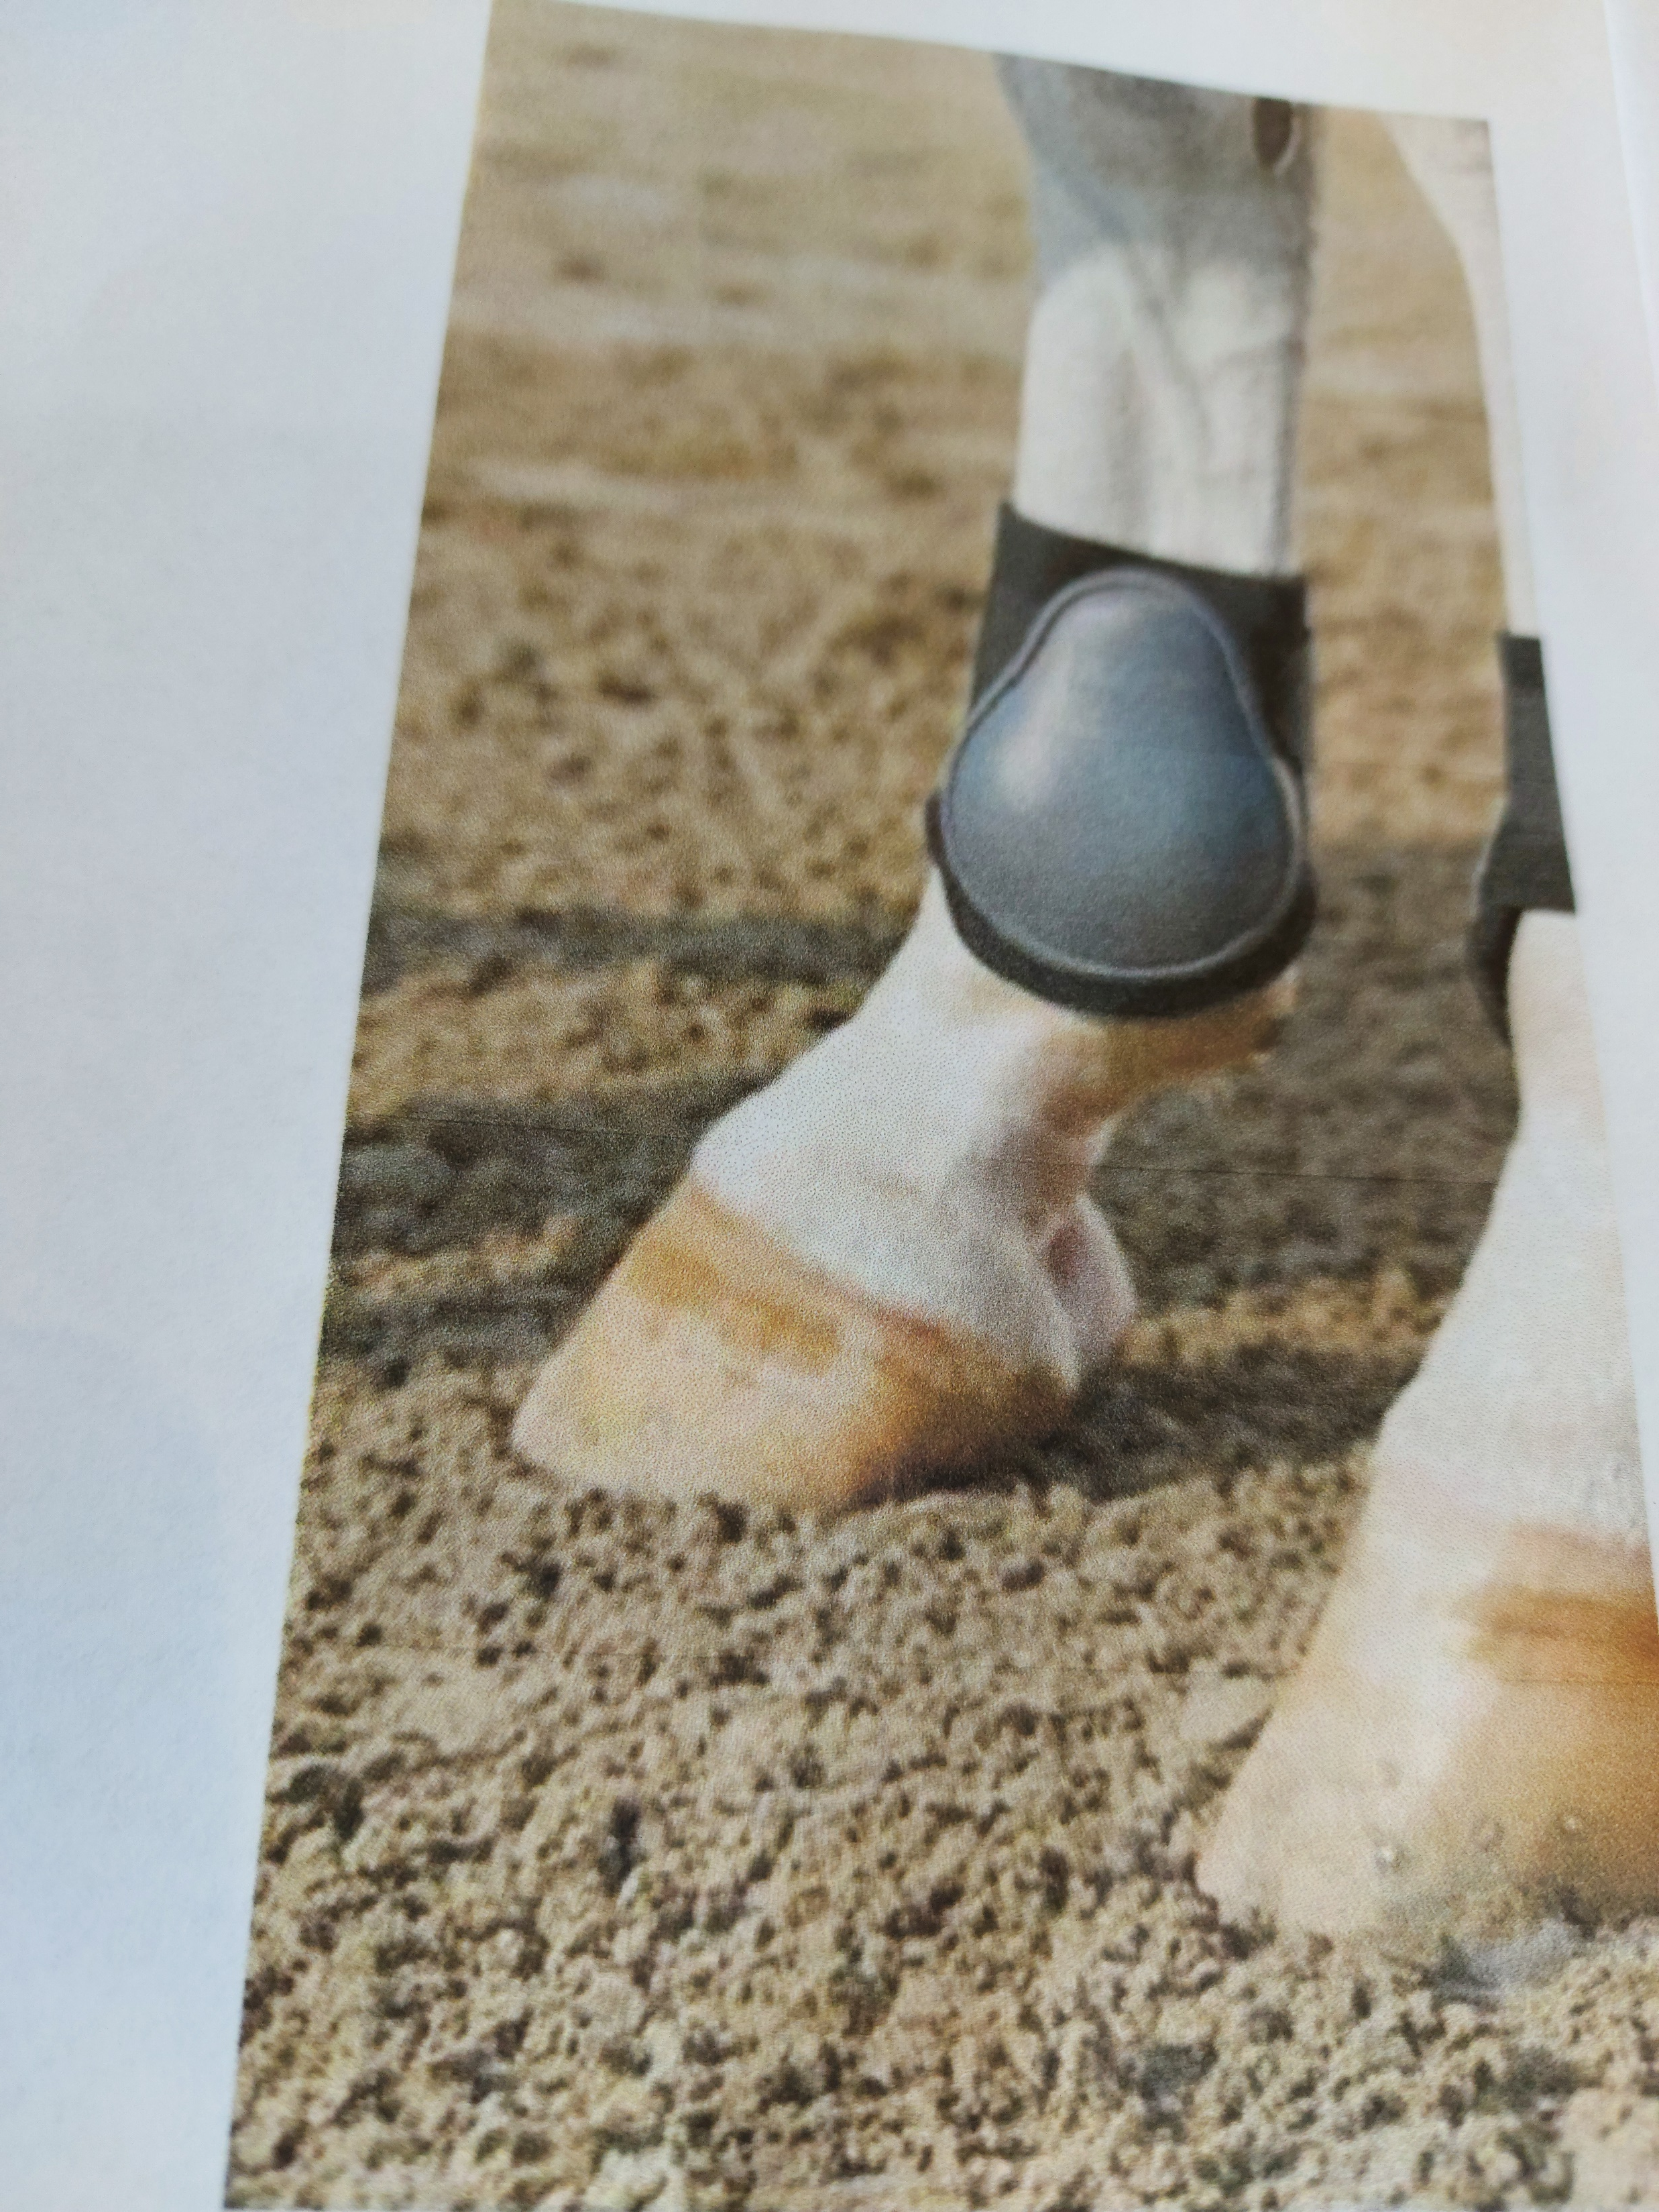
Young Horse Boots, Inside Protection Only and Single Velcro fastening with NO ELASTIC.

Slide 25

Kentucky boot Allowed with or without sheepskin.

Slide 26
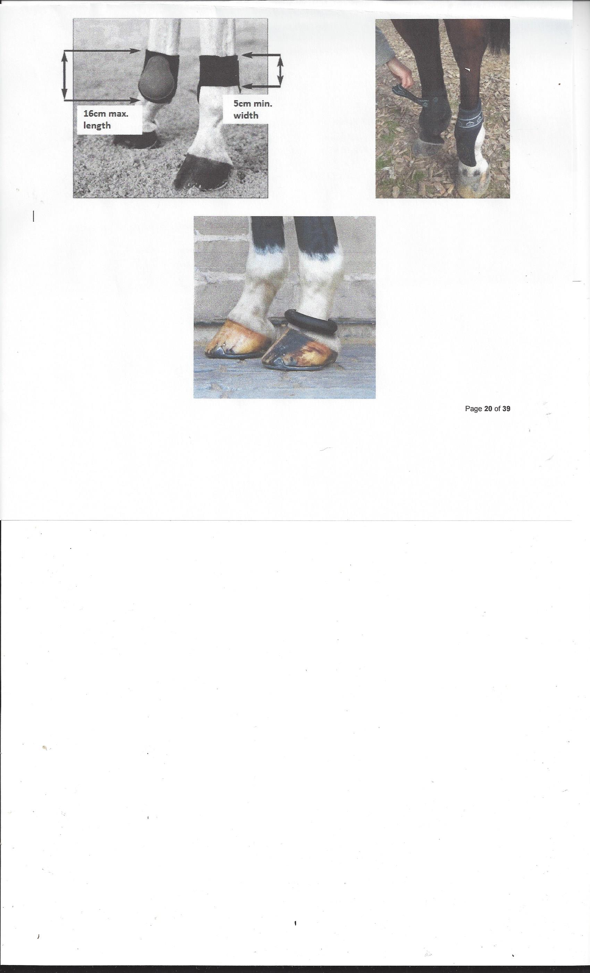
Young Horse Boots

Slide 27
SPURS
HORSE COMPETITIONS— ROWEL SPURS WITH SERATED EDGES ARE NOT ALLOWED ANYWHERE ON SHOWGROUNDS
ROWEL SPURS WITH SMOOTH EVEN EDGE DISCS ARE ALLOWED.
PONIES AND CHILDREN ON HORSES ---BLUNT METAL SPURS , Max length 4cms measured from the boot.

Slide 28
LIMBS.
Hair on limbs must not be clipped and /or shaved at any point during the period of an event. (unless for veterinary purposes).
Limbs may be clipped up to 3 days prior to an event but must not be clipped with a blade that cuts the hairs shorter than 2mm.

Slide 29
FROM JULY 2021
SENSORY HAIRS MAY NOT BE CLIPPED / SHAVED. (Unless they have been removed by a Vet to prevent pain or discomfort to the horse)
SENSORY HAIRS ARE THOSE AROUND THE MUZZLE AND THOSE AROUND EYES THAT ARE USED FOR SENSATION.

Slide 30
Nosebands must not be overtight.
Two Fingers placed flat should be able to fit between cheek and noseband.

Slide 31
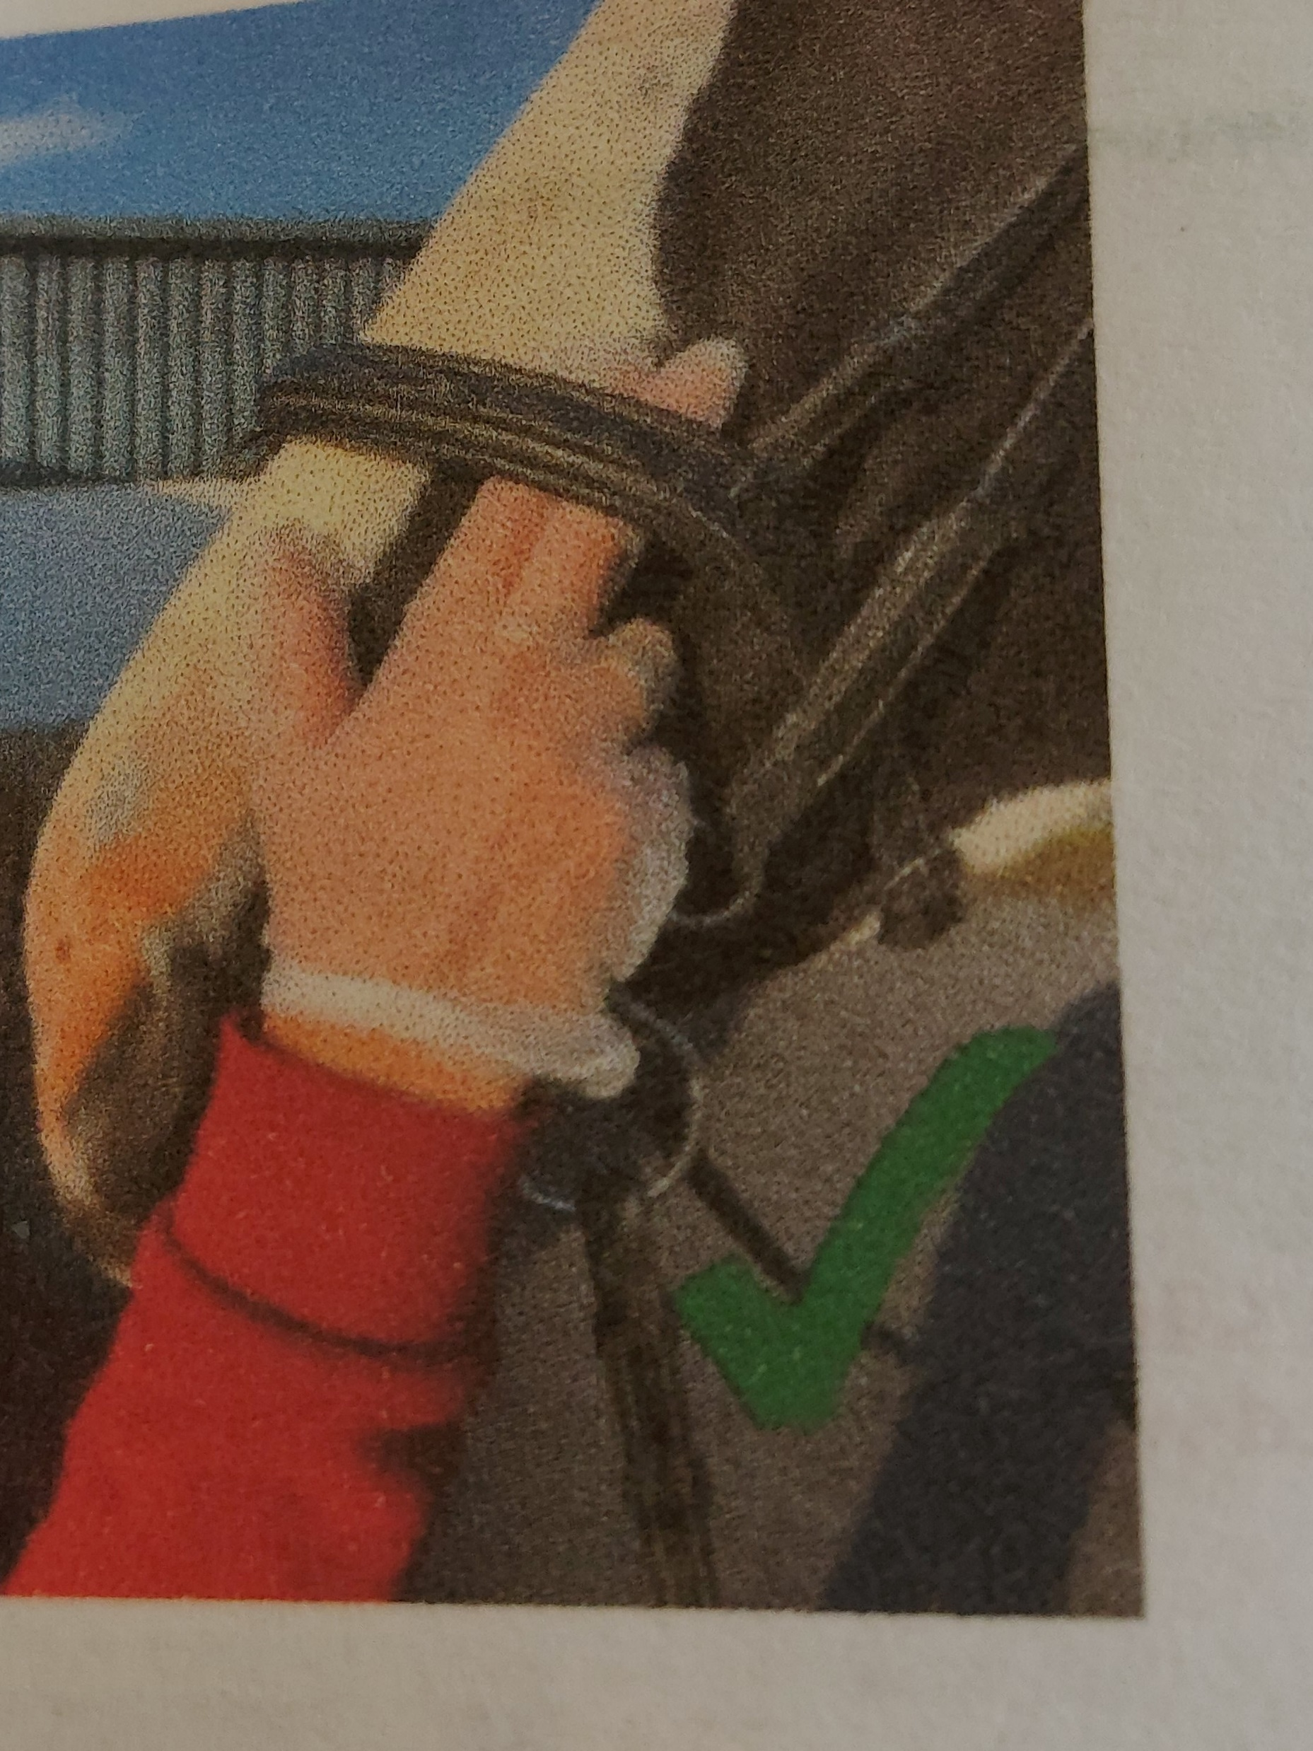
CHECKING TIGHTNESS OF NOSEBAND CORRECTLY

Slide 32
X POLE AT PRACTICE FENCE
ANY COMPETITION AT 1.30 OR ABOVE
THE ENDS OF X POLES IN THE CUPS CANNOT BE HIGHER THAN 1.30m

